Slide 1
U.S. Grocery Store Sales
David Brehm
DSC 630

Slide 2
Background
The recent pandemic has had an effect on many parts of our country, with the economy being one of the clearer ones. The shutdowns caused large spikes in many of our economic indicators that get tracked. One of these indicators that would have been very visible on a daily basis is grocery store sales.
The goal of this project is to investigate these recent fluctuations and historical sales data. This will reveal if other main national economic indicators track with grocery store sales and if they could be used to predict future sales.

Slide 3
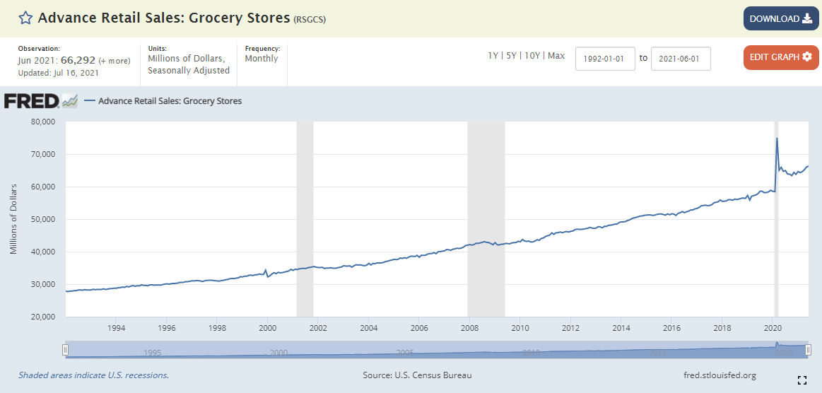
Data Sources
The data for this project is multiple national economic indicators including grocery store sales. The economic indicators used are from various US government entities such as the US Bureau of Economic Analysis or the US Census Bureau.
The Federal Reserve Bank of St. Louis compiles many of these indicators, and this is the source this project’s data is obtained from.
US monthly grocery store sales visualized by the Federal Reserve Bank of St. Louis

Slide 4
Data Sources
The economic indicators selected for this analysis are:
Gross Domestic Income
Quarterly data since 1947, seasonally adjusted.
Consumer Price Index for Urban Consumers
Monthly data since 1947, seasonally adjusted.
Grocery Store Sales
Monthly data since 1992, seasonally adjusted.
Unemployment Rate
Monthly data since 1948, seasonally adjusted.
Total Consumer Credit
Monthly data since 1943, seasonally adjusted.
Population
Monthly data since 1959.
Real Median Personal Income
Annual data since 1974.
10-Year Breakeven Inflation Rate
Monthly data since 2003.

Slide 5
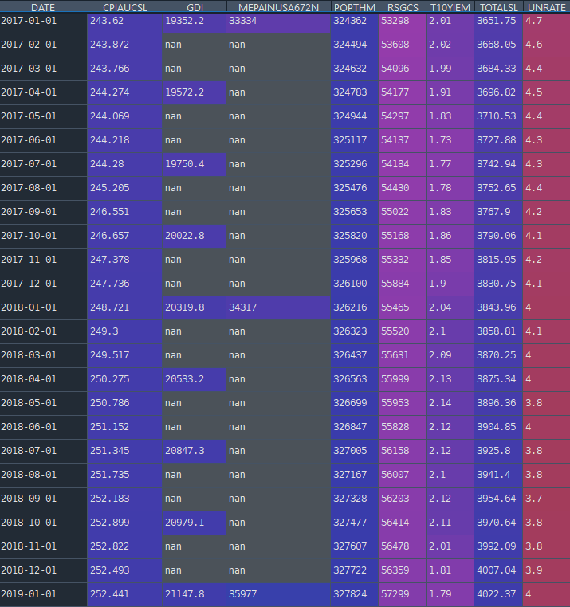
Initial Data Insights
Combining the individual data sources was relatively straightforward. Since all of the data was from the Federal Reserve Bank of St. Louis, the metrics had the same date values. These separate files could therefore simply be merged by date.
Not all of the data sources had the same reporting frequency however, which resulted in missing values in some cases.
Initial combined data sources

Slide 6
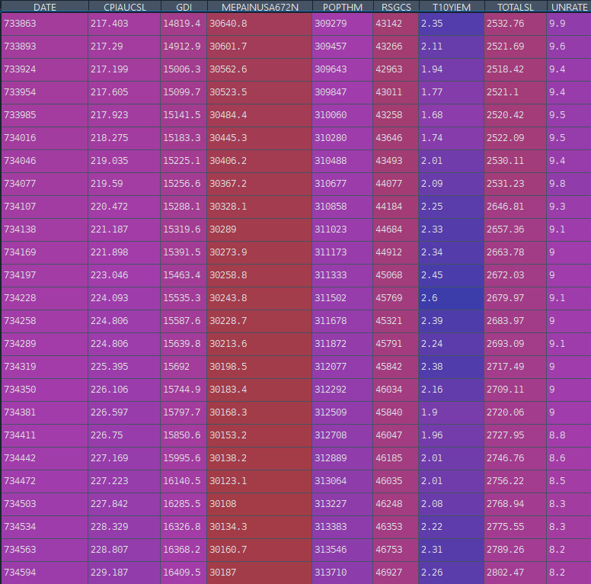
Initial Data Insights
The inflation rate metric is the limiting factor in terms of date range, only having data since 2003. This reduced the dataset to 220 entries.
Missing values for each feature were filled through linear interpolation, and the dates were converted to ordinal in order to work with the model.
Cleaned dataset

Slide 7
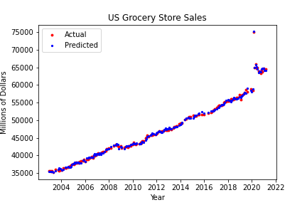
Modeling
The model used for this analysis was polynomial regression. Using a degree of 2 resulted in the highest R² value for this model.
Polynomial Degrees | R²
2 | 0.9946
3 | 0.9832
4 | 0.8116
5 | 0.9333
6 | 0.9570
Regression Model predictions

Slide 8
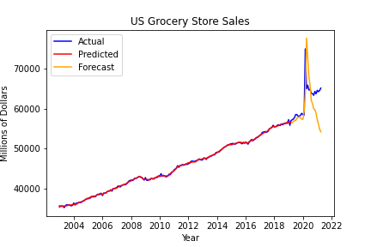
Modeling
Splitting the testing and training dataset by month in order to simulate forecasting future sales results in much worse results.
This resulted in a new R² value of -0.81605.
Polynomial Regression predictions

Slide 9
Summary
Using a polynomial regression model to predict national grocery store sales had mixed results. Before the pandemic, the selected features here did a very good job at predicting grocery store sales. By narrowing the focus around the pandemic however, the features here performed much worse.

Slide 10
References
All data used for this project is from the Federal Reserve Bank of St. Louis.
Federal Reserve Economic Data | FRED | St. Louis Fed. (n.d.-b). Federal Reserve Economic Data. https://fred.stlouisfed.org

